Slide 1

Bank Marketing
https://github.com/gilangbagus-rama/3311801026_datamining_polibatam

Slide 2

Anggota Kelompok
Nur Fhitriani Megadyanty (https://github.com/nurmega)
Heryanto Hasudungan (https://github.com/herysirait)
Gilang Bagus Ramadhan (https://github.com/gilangbagus-rama)

Slide 3
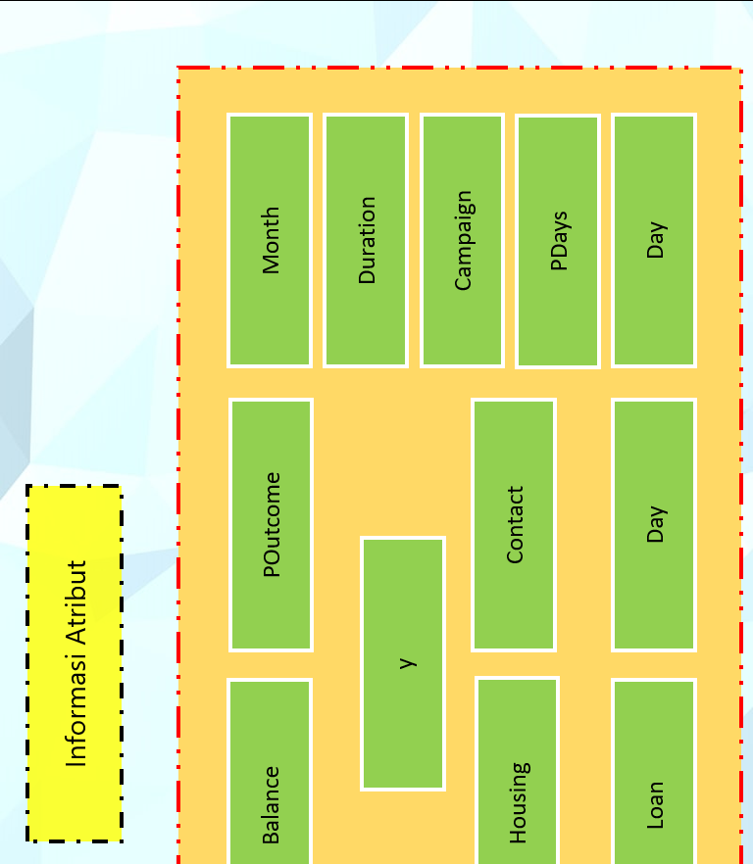

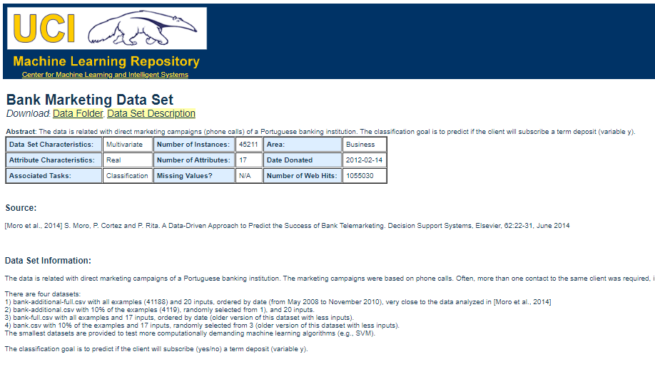
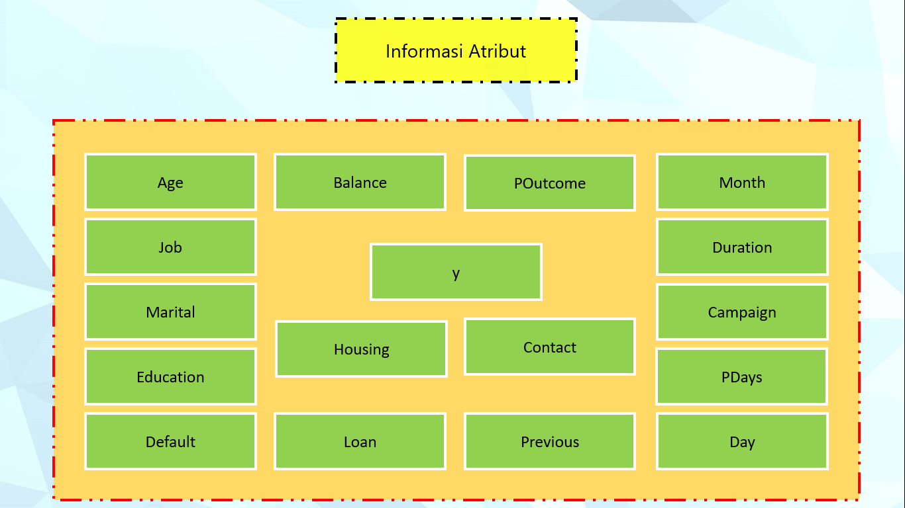
Bank Marketing Data Set
https://archive.ics.uci.edu/ml/datasets/Bank+Marketing

Slide 4

Informasi Atribut
Age
Balance
POutcome
Month
Job
Duration
y
Marital
Campaign
Housing
Contact
Education
PDays
Default
Loan
Previous
Day

Slide 5

Proses Pengerjaan

Slide 6

Referensi
[1] Udacity. 2015. Classification Learning One - Georgia Tech - Machine Learning di https://www.youtube.com/watch?v=IrM0MNi_Kxk, diakses pada 27 November 2019
[2] Udacity. 2015. Comparing Classification and Regression di https://www.youtube.com/watch?v=G_0W912qmGc, diakses pada 27 November 2019
[3] Learning Polibatam. 2019. Data Mining – Minggu 8 dan Minggu 9 di https://learning-if.polibatam.ac.id/course/view.php?id=12 , diakses pada 28 November 2019

